Slide 1

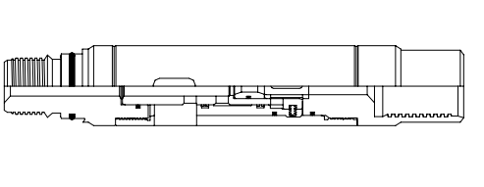
Thru-Tubing Inflation Valve
Editor: Jalal Alali
2018.05

Slide 2
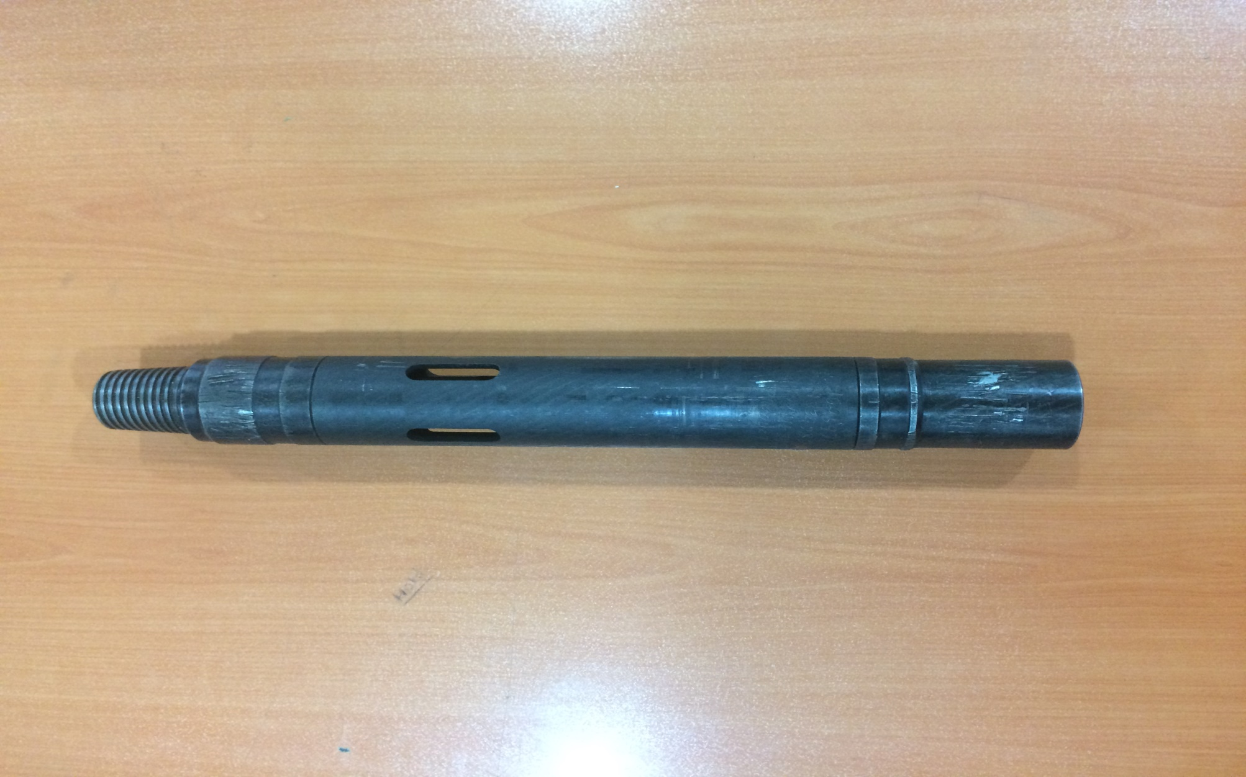

Slide 3
CONTENT
Introduction of Tool
Disassembly
Assembly

Slide 4
The Thru-Tubing Inflation Valve is run in order to provide a communication path from the tubing to the annulus so that fluid can be circulated down the tubing while running in the hole. Another important function of the inflation valve is to equalize the pressure from the tool ID to the wellbore while running in the hole. This prevents damage to the inflatable element and insures that the poppet is not seated too tightly in the poppet seat by wellbore pressure.
Introduction:

Slide 5
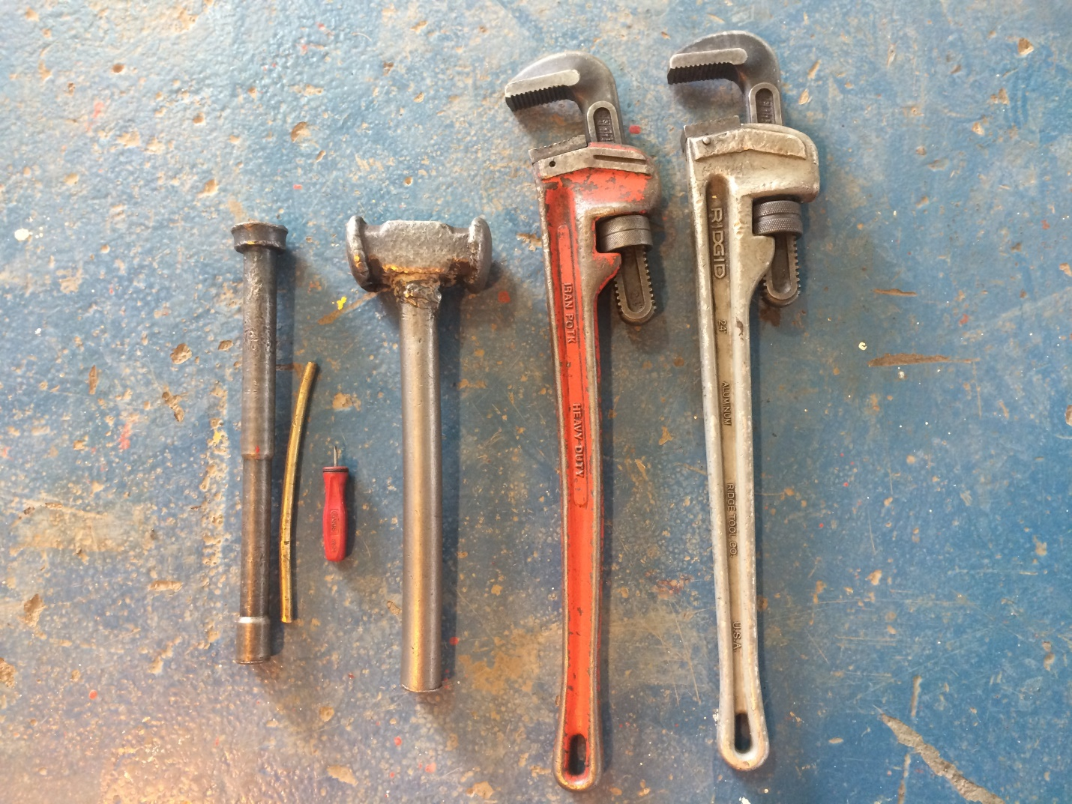
Required hand tools
Pipe Wrench
Screw driver
Special tool
hammer

Slide 6
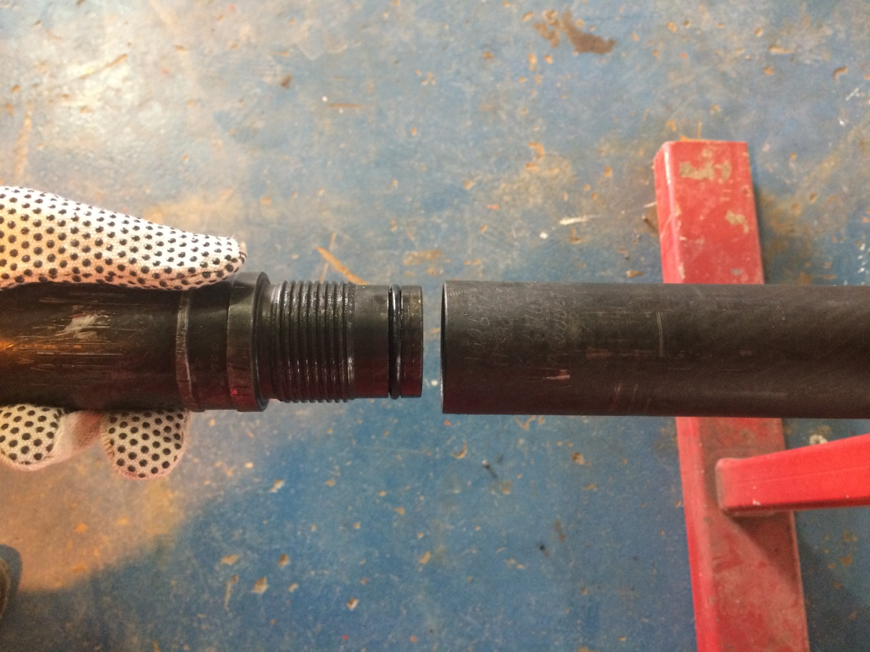
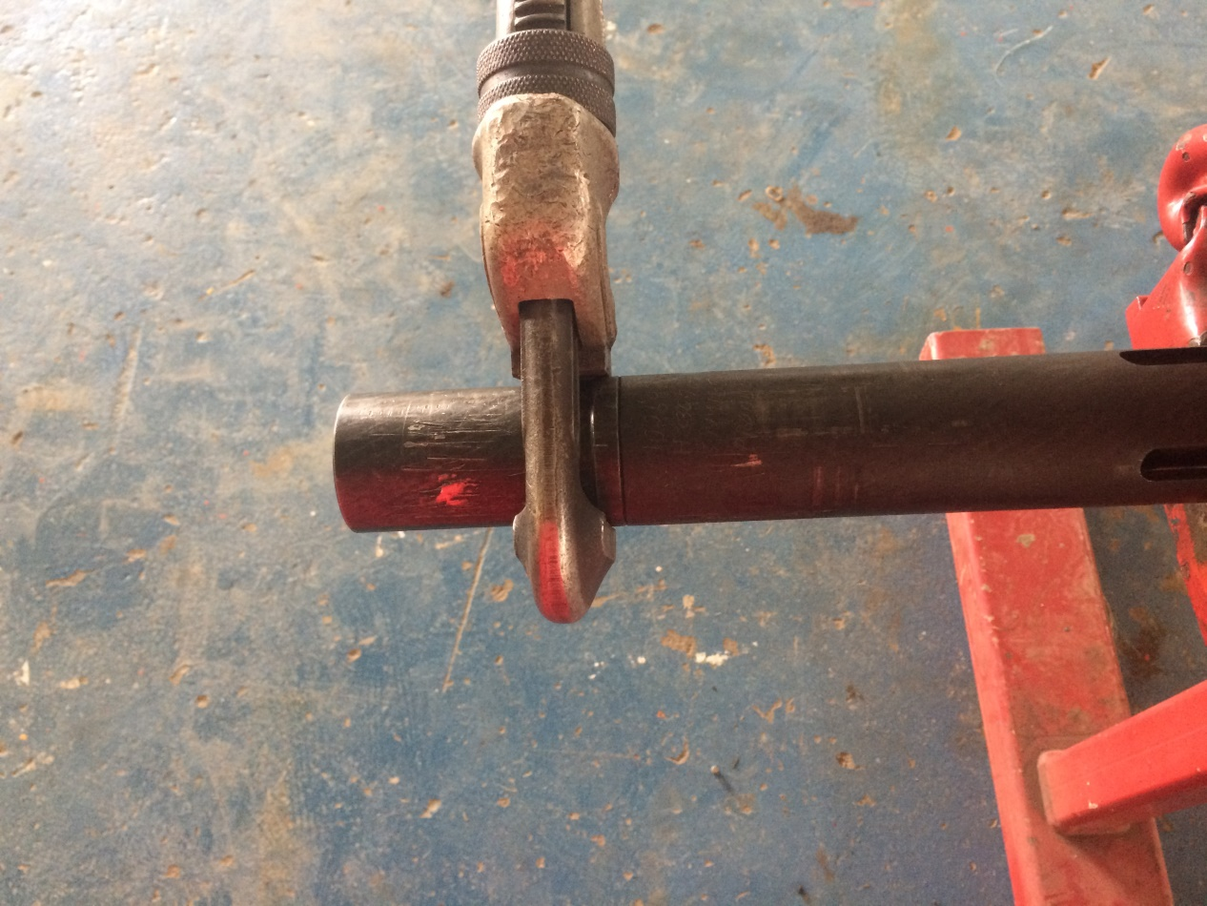
Disassembly
1- Place tool in vise at housing
2- Unscrew top sub from housing
body
A
B
Top sub

Slide 7
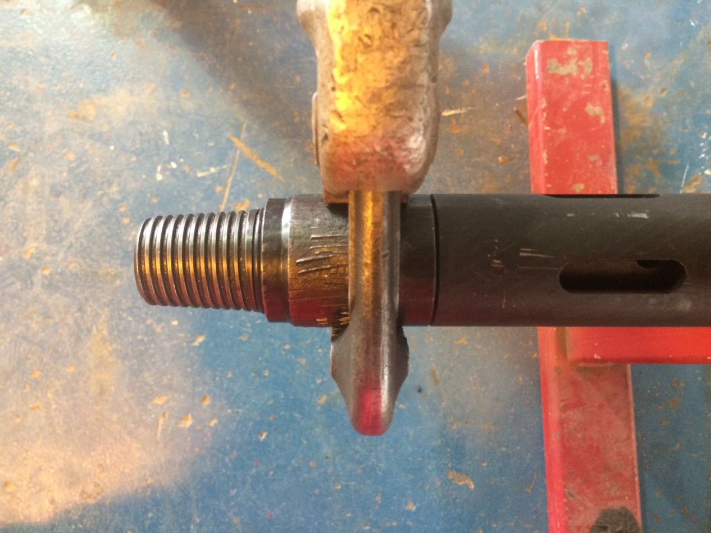
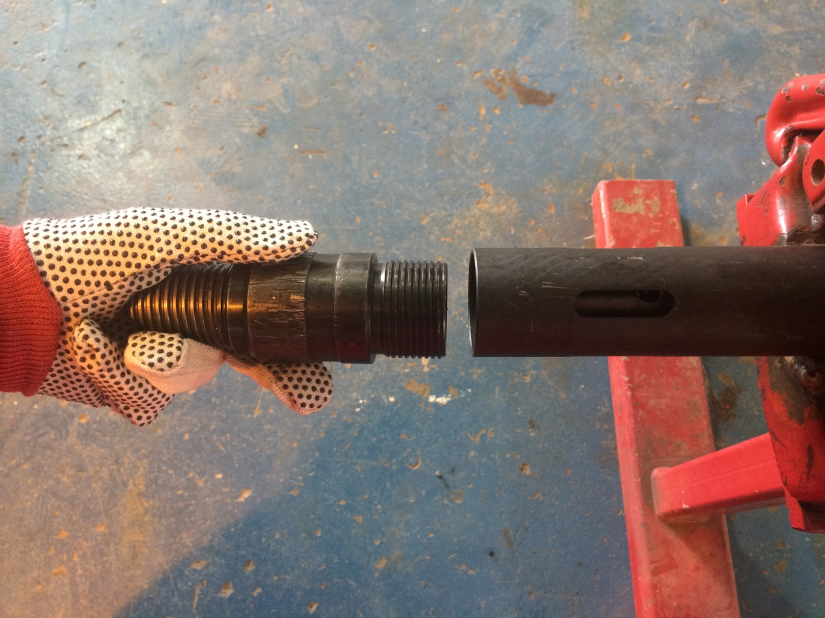
3- Unscrew bottom sub from housing
body
A
B
Bottom sub

Slide 8
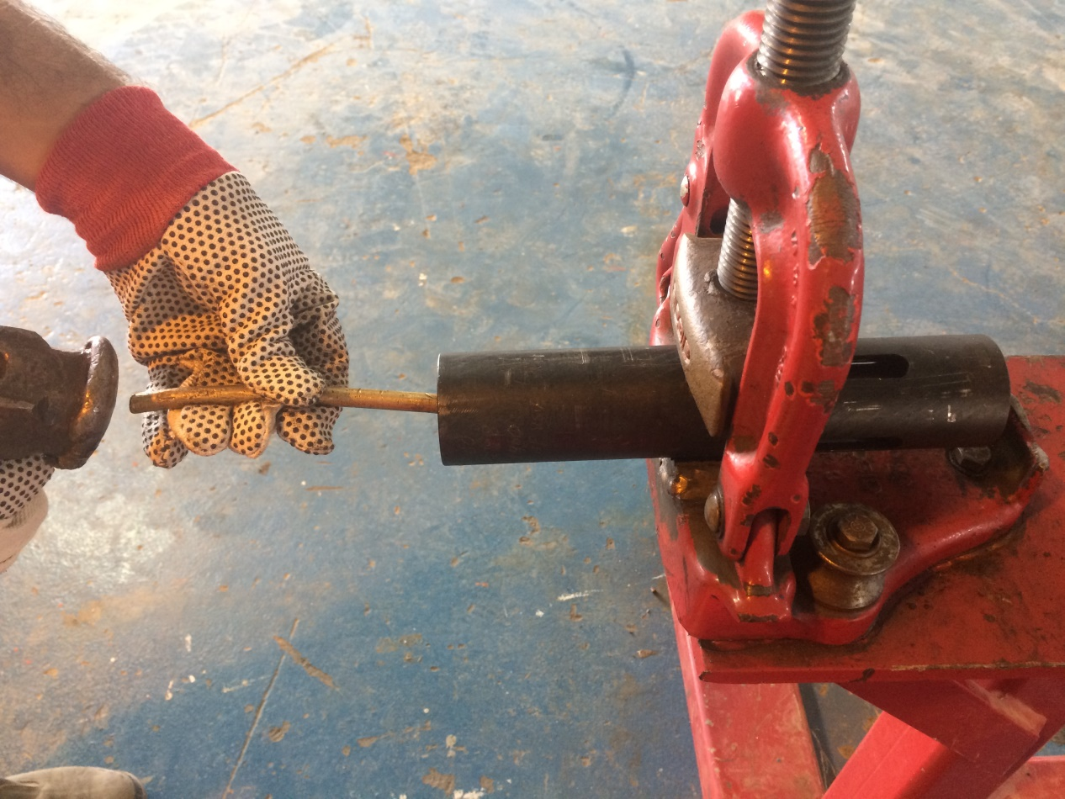
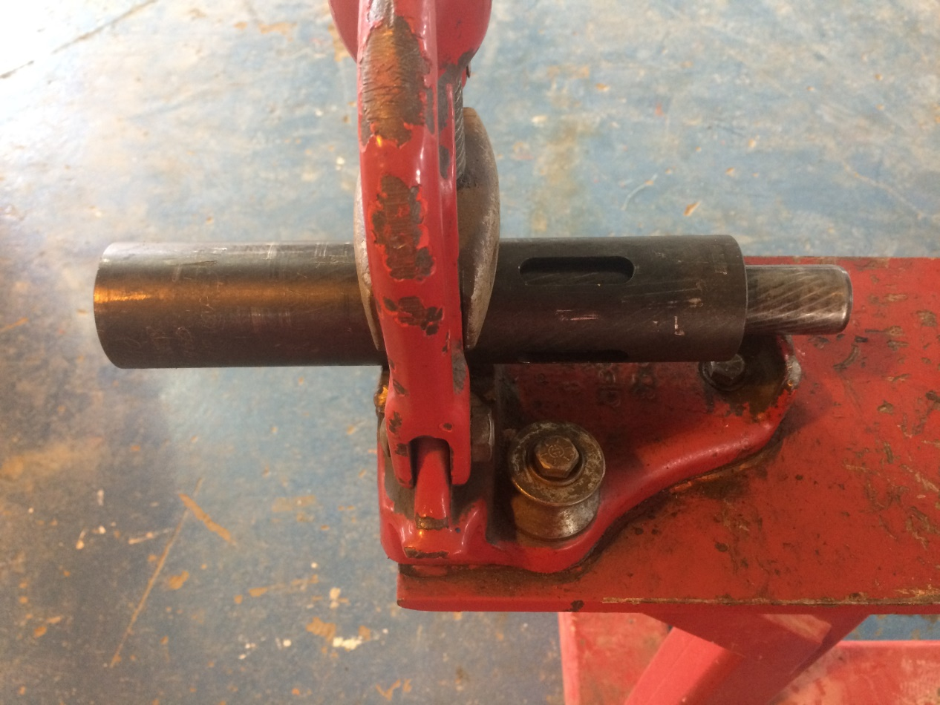
4- slide body and piston out of housing .
Slide Body
A
B

Slide 9
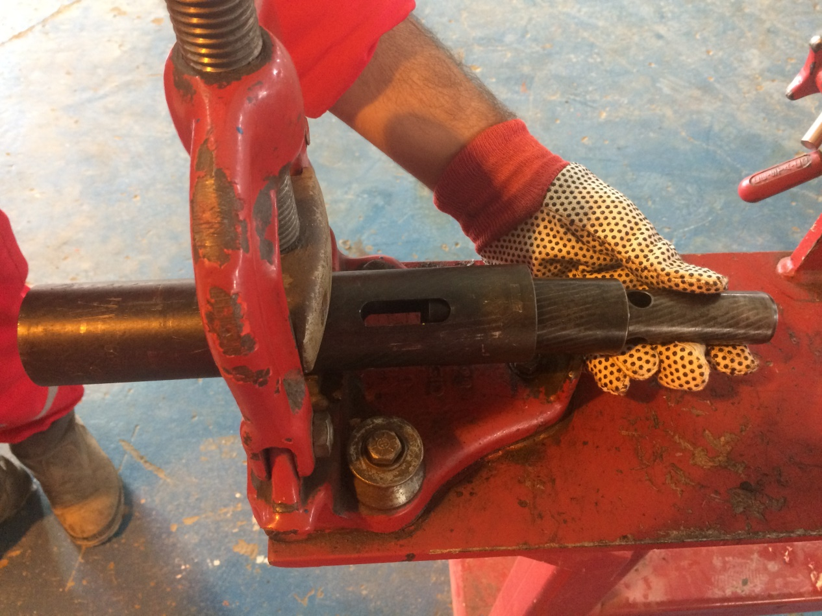
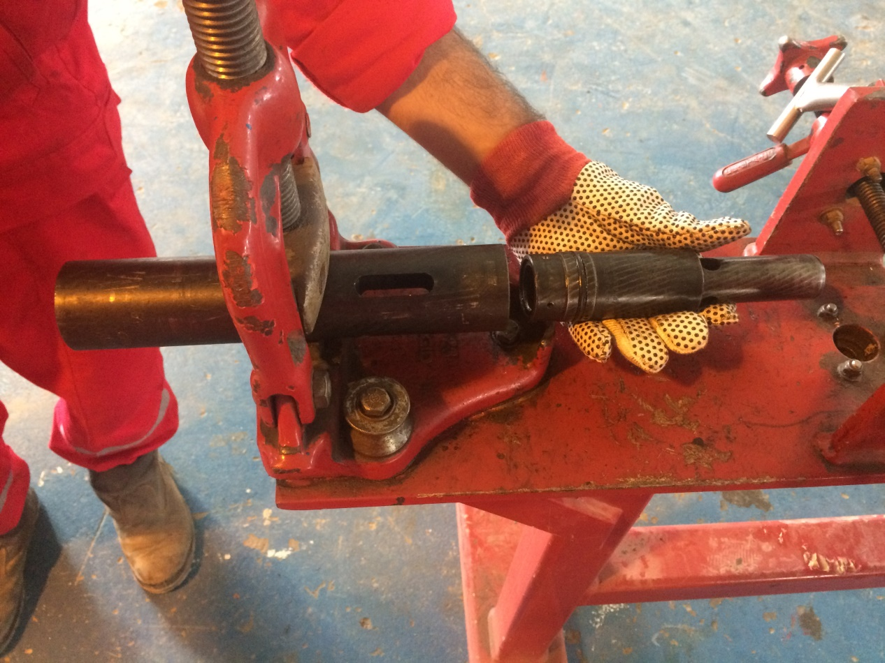
4- slide body and piston out of housing .
A
B
Piston
Slide Body

Slide 10
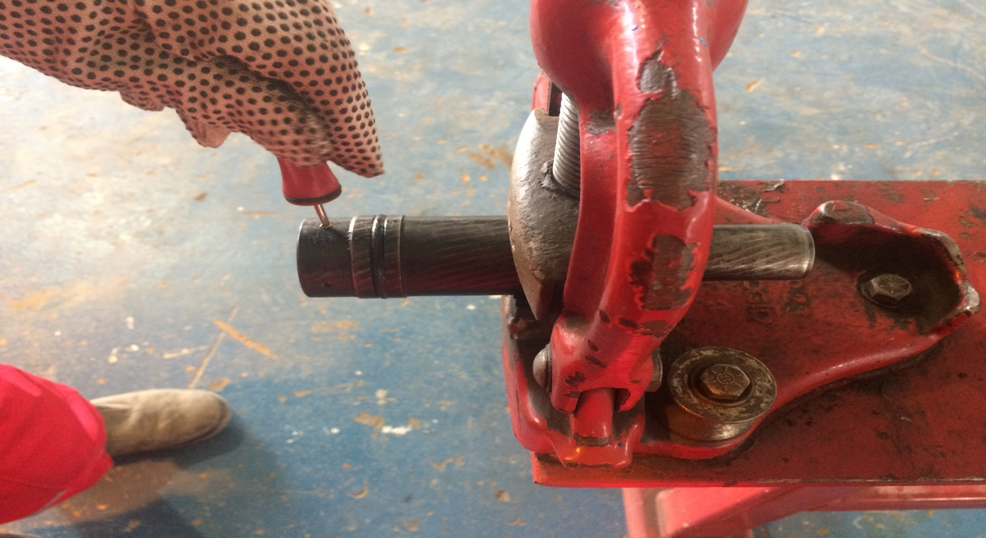
5- remove shear screws from piston .
Piston

Slide 11
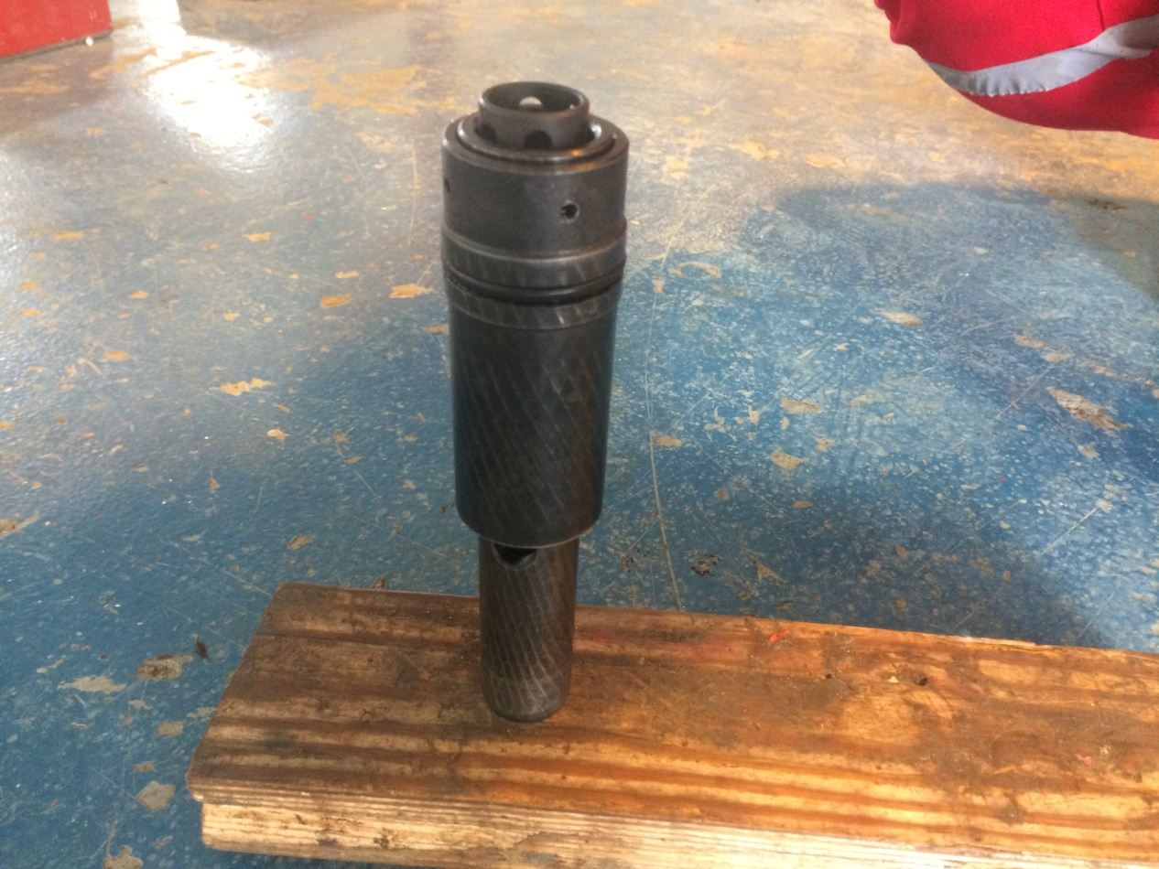
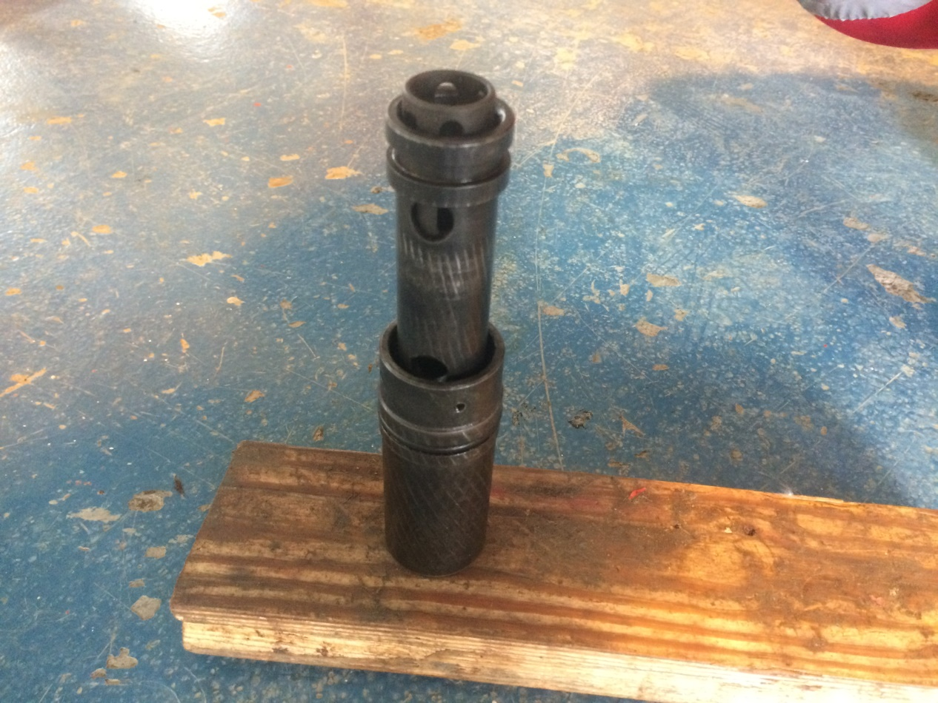
6- Slide piston out of body . 7- slide spacer sleeve and ball seat out of body .
Piston
A
Push
B
Slide Body

Slide 12
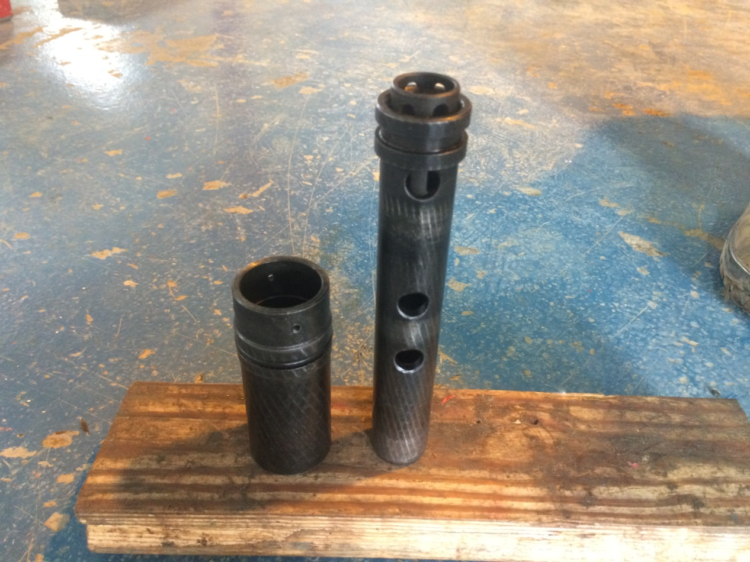
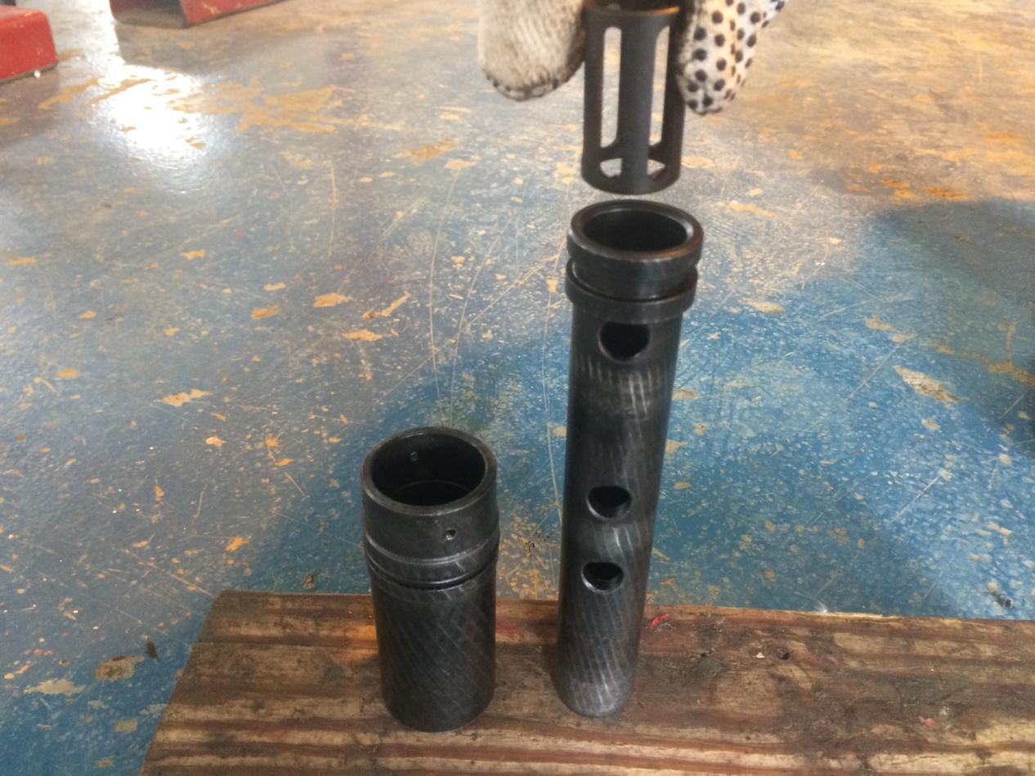
6- Slide piston out of body . 7- slide spacer sleeve and ball seat out of body .
Spacer Sleeve
A
B
Piston

Slide 13
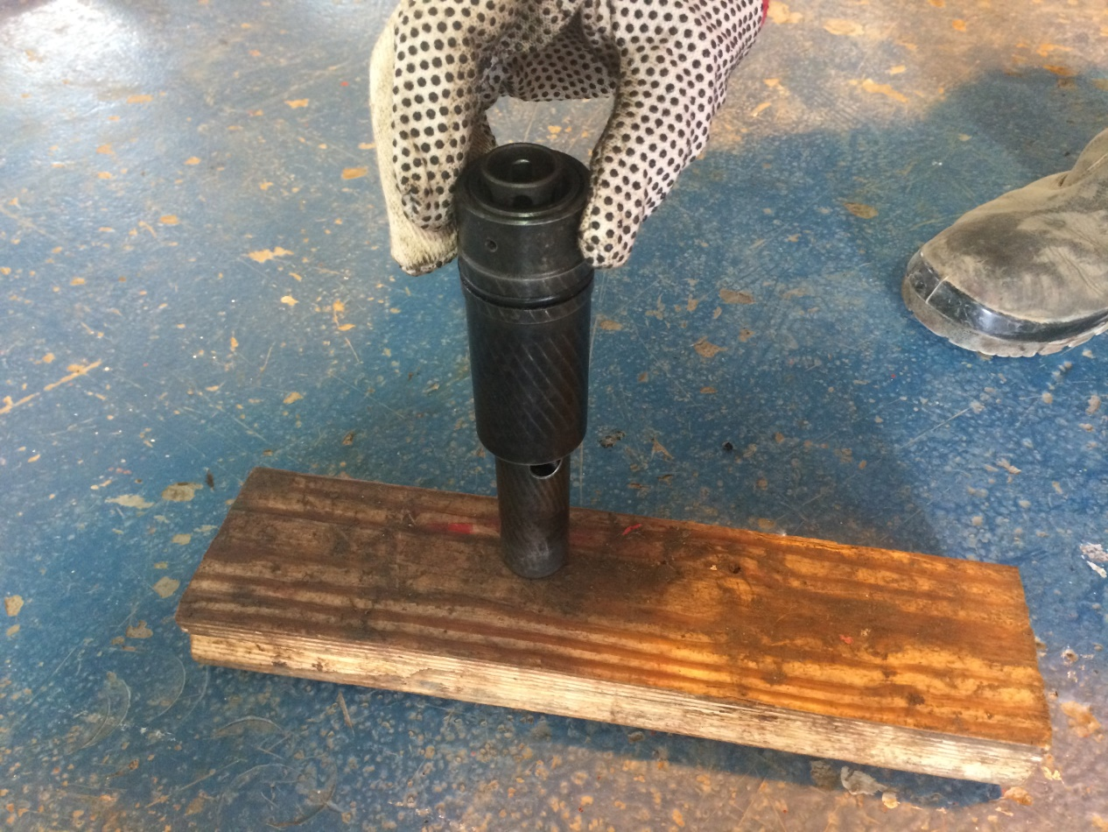
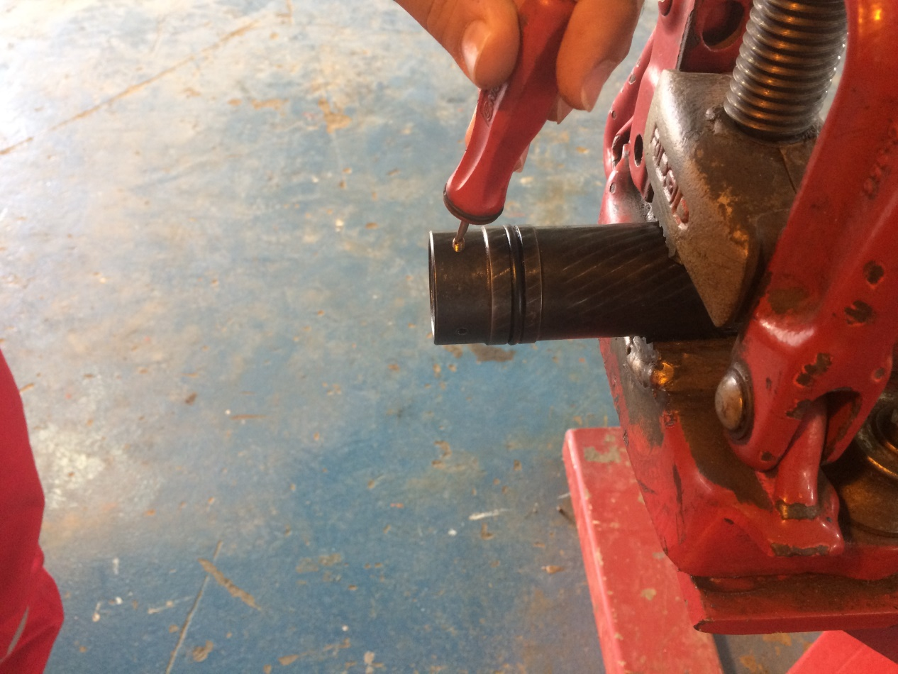
Assembly
1- install all O-rings and apply a light coat of grease to the threads and seal bores .
2- slide piston over body and install shear screw
A
B

Slide 14
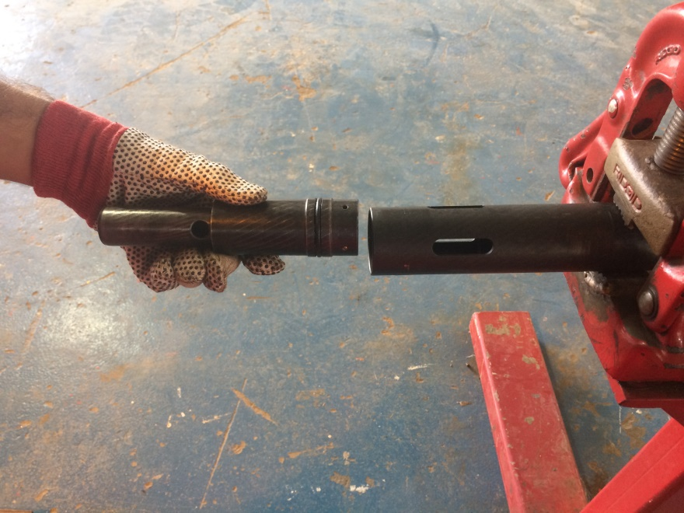
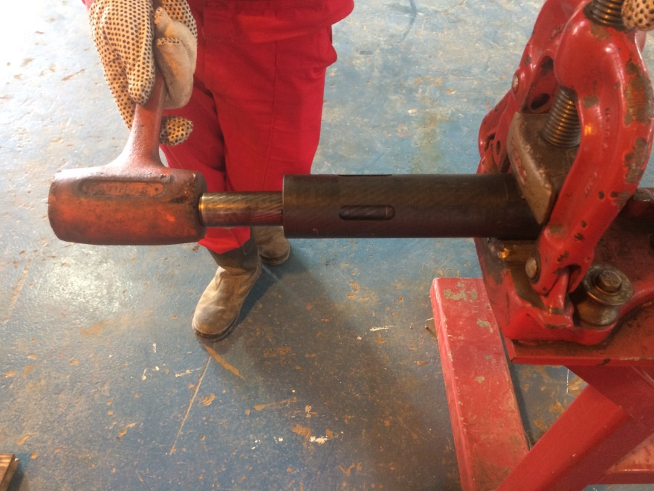
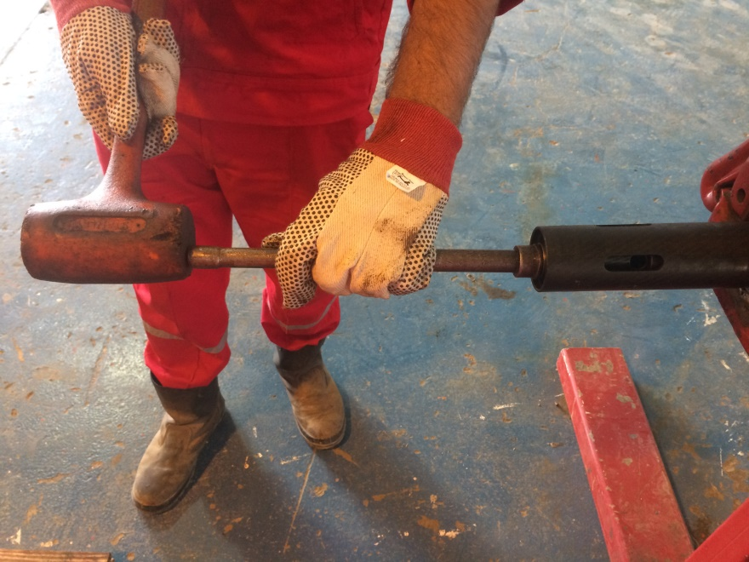
3- place bottom sub in vise .
4- make up housing to bottom sub .
5- slide ball seat and spacer sleeve inside body .
6- slide body assembly inside housing .
A
B
C
piston
Body ( housing )

Slide 15
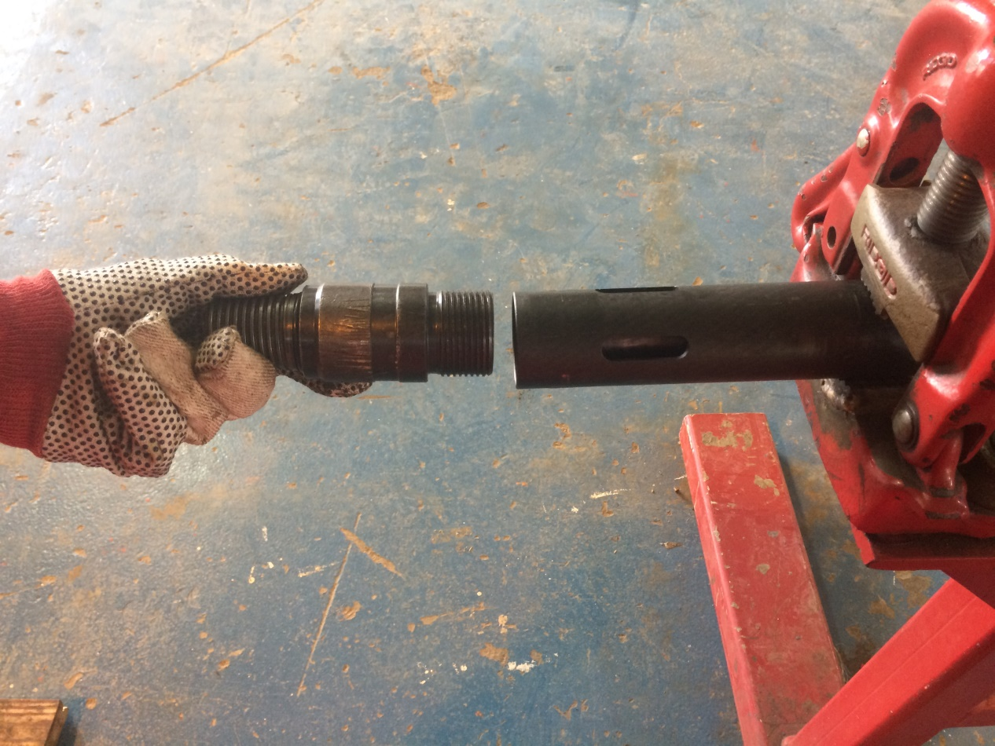
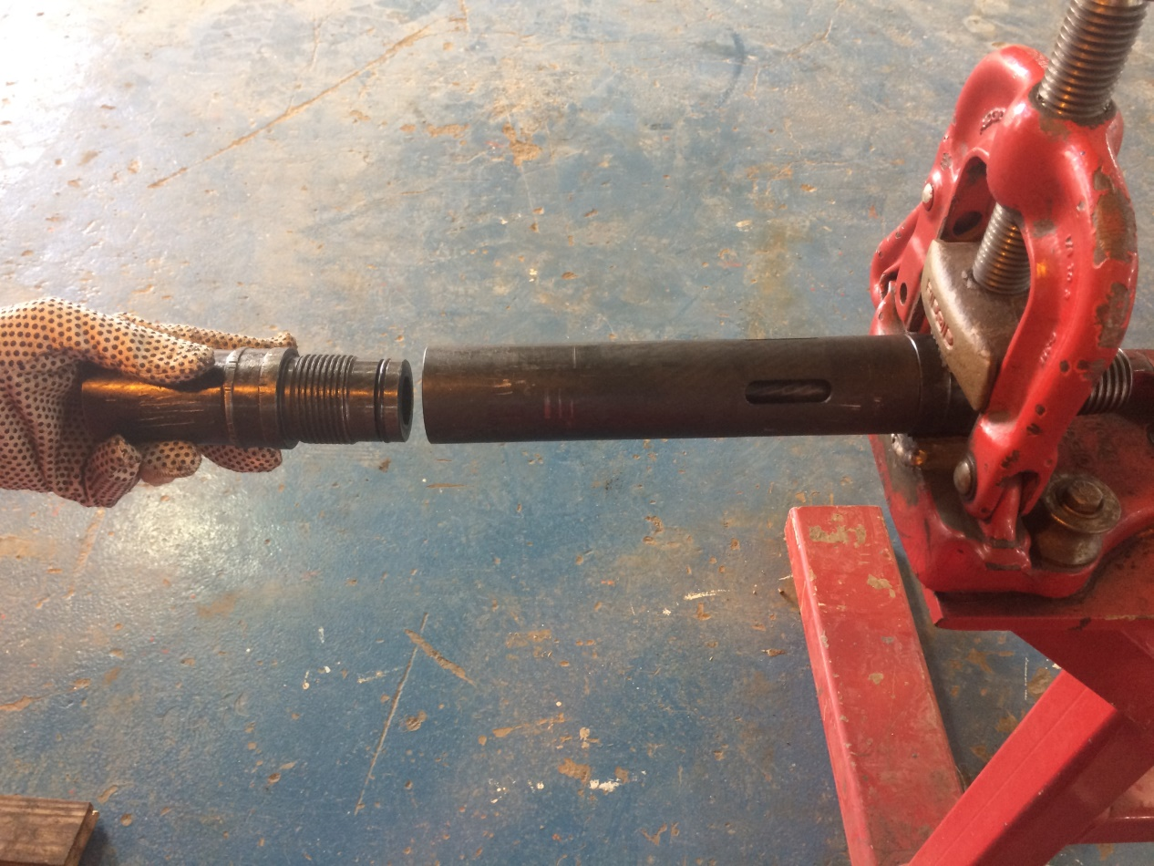
7- make up bottom sub into housing .
8- make up top sub into housing .
A
B
Housing
Top Sub

Slide 16
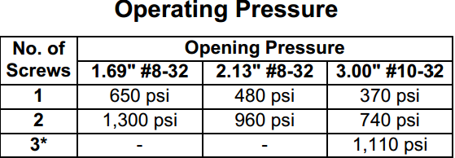
Notice : *Maximum No. of shear screws recommended in the 1.69" and 2.13" tools are (2) and in the 3.00" tool is (3) .

